Slide 1
BARC Tube Bending Week 5

Slide 2
Checklist
Process: Manual Edge detection Smoothing edges Fitting lines to straight sections Angle Calculation Part 1 ( Bends 1 & 2) Part 2 ( Bends 2,3 & 4) Automated Edge detection Smoothing edges Fitting lines to straight sections Angle Calculation Part 1 ( Bends 1 & 2) Part 2 ( Bends 2,3 & 4) | Varying Parameters: Background Color Background Brightness Distance to LED box Height of camera Camera Orientation Lighting (Front vs Back) Different cameras/lenses Adding noise (non-ideal lighting conditions) No. of Cameras

Slide 3
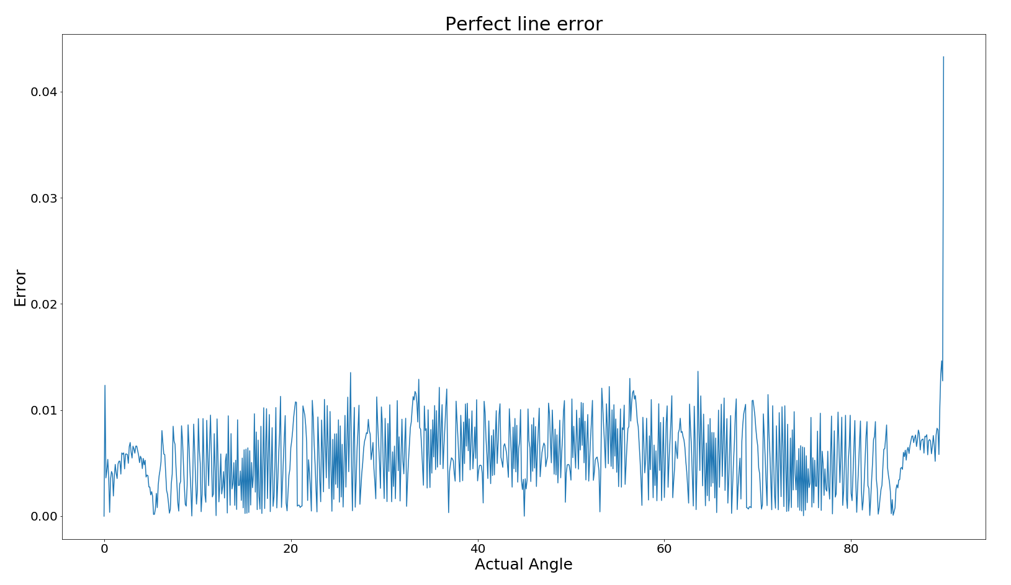
Last Week Result: Higher Resolution Error
The resolution of the camera right now is 2K (2448 * 2048).
The pixel length of the bending part is approximately 500px.
Increase resolution to 4K, pixel length to 1000px.

Slide 4
Current Week Effort
Angle Error Plot Trend
Obtain a plot of angle error on increasing the number of pixels in an ideal straight line
Gain insights on resolution of image, maximum error and mean error from the plot
Angle Calculation using in-built function
Use houghlines function that uses hough line transform to fit straight lines tothe edges
Calculate angles using all combinations of lines

Slide 5
1.1 Angle Error Plot Trend: Procedure
For a set of angles(0-45), fix a default number of pixels to an ideal straight line
Increase the number of pixels and plot angle error for increasing pixel lengths

Slide 6
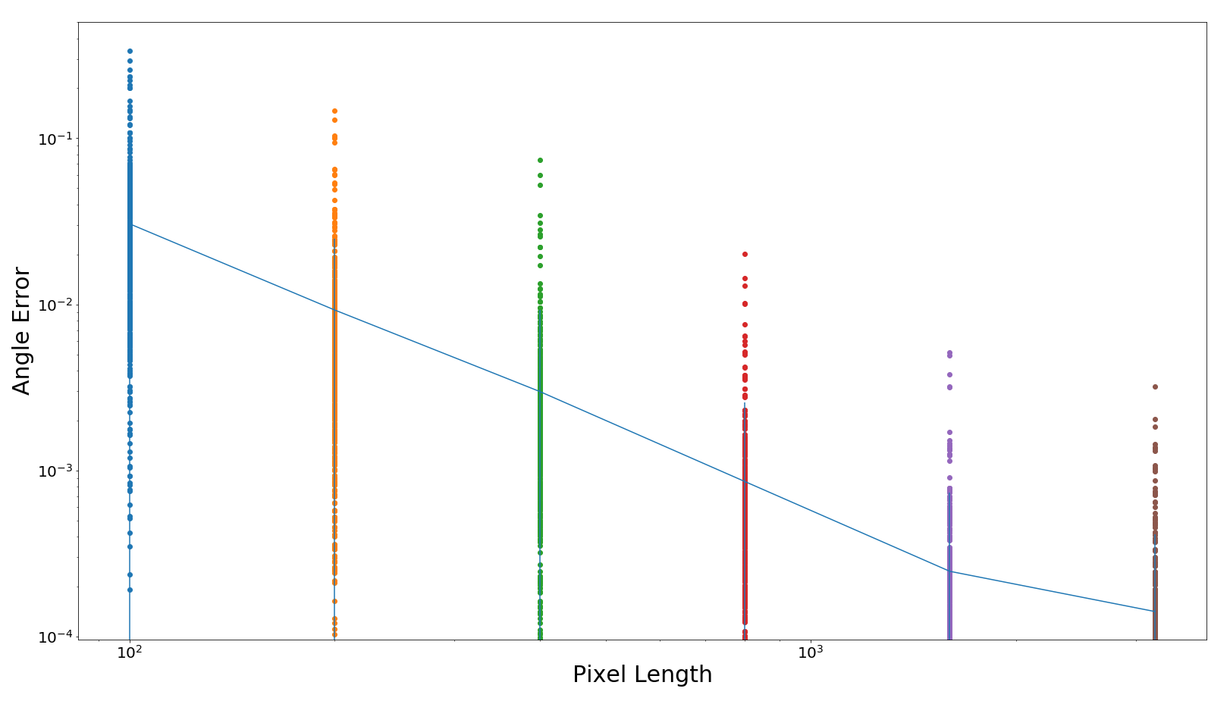
1.2 Angle Error Plot Trend: Plot
Information obtained:
Angle error for 0-45
Mean error
Deviation

Slide 7
1.3 Angle Error Plot Trend: Insights
General decreasing error trend as the pixel length increases
For pixel lengths of the order of 10^3 and higher, the error is close to 0.001 (required: 0.05-0.1)
This substantiates our assumption that a camera with higher resolution will lead to more precision in angle calculation

Slide 8
2.1 Using Houghline function: Procedure
MATLAB’s in-built houghlines function used
Function fits straight lines using hough transform
The line fitting depends on:
Distance between pixels
Number of pixels

Slide 9
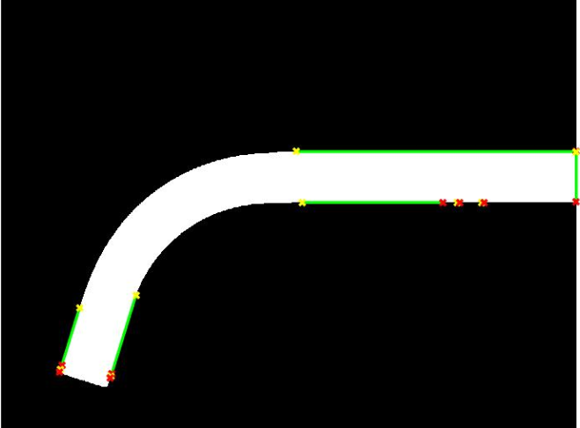
2.2 Using Houghline function: 0.1 factor
Threshold factor = 0.1
Angle error right edge = 0.0981
Angle error left edge = 0.1284

Slide 10
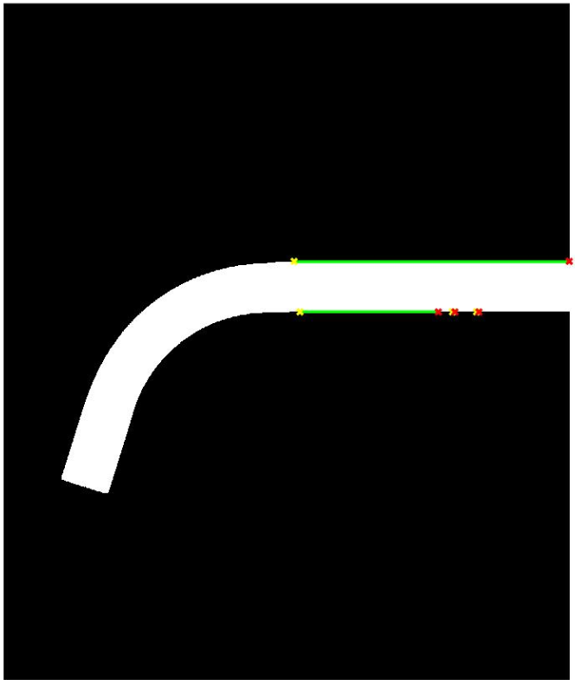
2.2 Using Houghline function: 0.3 factor
Threshold factor = 0.3
Could not get line fit for slant section

Slide 11
Future Work
Do some noise analysis of the camera.
Modify the Houghline algorithm to improve its robustness for our case.

